Slide 1

IBM
PROJECT 05
Creation of Domain specific Bots using an Agent Bot

Slide 2
To both our internal mentor Mr. Amlan Jyoti Boruah and our external mentor Mr. Aditya Maheswari for helping and assisting us along the way. Also thank you Dr. Sajal Saha and IBM for giving us this oppotunity.
WE ARE THANKFUL TO

Slide 3




Obj. & Introduction Technology Used Interface & Bots Applications & Future Aspects
CONTENTS

Slide 4


Obj.: Creation of Domain specific Bots using an Agent Bot.
Creation of a modular assistant that can handle a number of requests and queries related to specific domains.
A person may end up switching between various bots for their queries.
A singular interface which redirects the user query.
INTRODUCTION

Slide 5


TECHNOLOGY USED
IBM Cloud
IBM Watson Assistant Node.js
IBM Cloud Foundry
IBM Cloud Developer Git

Slide 6
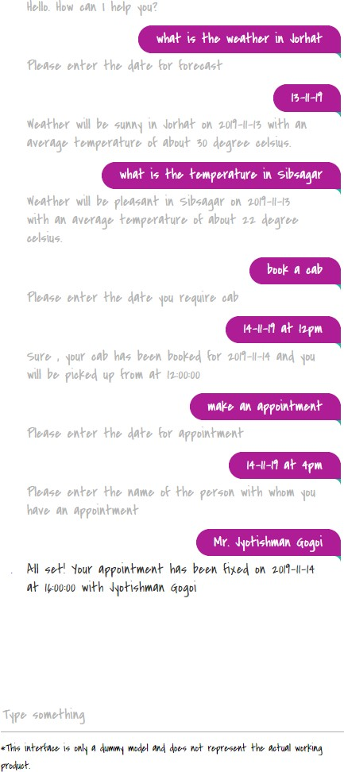
INTERFACE & BOTS
The Agent Bot (Interface)
Through which the user communicates with the bots
The Travel Bot
Travel related inquiries
The Weather Bot
Weather forecast and general temperature
The Appointment Bot
Keeps tabs on your meetings and appointments

Slide 7

APPLICATIONS
&
The Modularity of this system allows for extensive customization as per as our needs. The ability to add or remove bots as required allows us to create the system of our choice. Also small things like changing the color and font gives it a more personal feel.
FUTURE WORK

Slide 8
The End!
THANK YOU
CSE 7 th Sem

